Slide 1
Album Cover Analysis
Acoustic/Indie

Slide 2
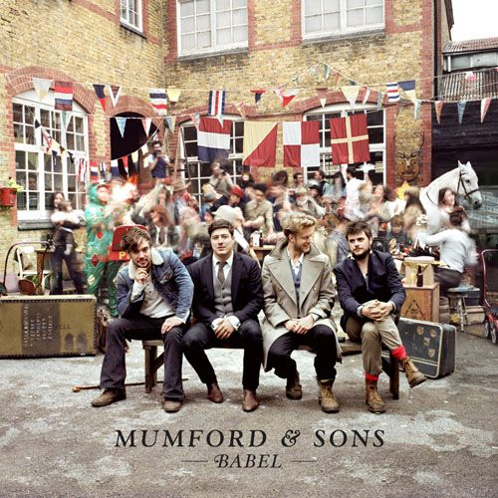
Mumford and Sons
The album cover for Mumford and Sons shows a long shot of the band in a street celebration setting implying an era change; although, the band look of different class/status to each other in that the middle two are smartly dressed in suits and waistcoats and the two on either end are slightly more casual in denim jackets, coats etc. Two of the band members are also engaged in conversation whilst the other two are looking at the camera yet still with an uninterested look. This album cover challenges the typical conventions of the name of the artist or album name being at the top; important information is usually at the top of the page as it follows the line of vision yet Mumford and Sons differs by having both the band name and title of the album at the bottom of the cover below the band themselves. However, the band are within the focus point of the image and are further emphasised by a clear focus on them and a blur of the events occurring and people in the background. The font used for both the name of the band and album is the same and is the signature font that Mumford and Sons uses that allows all their records to be identifiable to their target audience which tends to be a broad demographic ranging from young adults to 30’s/40’s; the font is black which reflects upon the relatively mundane clothing being worn yet is a contrast to the colours within the background and on the flags. The font is Serif and the name of the band is bold and larger than the name of the album which shows the importance of the band’s fan base as it’s the artist which makes the album sell. The name of the album is smaller in size than the name of the band and is in an italic to still show importance and class but that the name of the band is more significant.

Slide 3
Mumford and Sons Continued
Editing would have been used to blur the background events and emphasise the band and their bags/equipment. Despite a primary focus being on the band the quality of the shoot implies they’re of a normal status and shows verisimilitude in that they’re still within the community which is a contrast to most album covers in which most artists want to be the prime focus of the shoot and usually use a close-up or mid shot to show their attractiveness and expensive clothing. Mumford and Sons are a clear representation of Neale’s theory in that they don’t want their album cover to look mainstream and aren’t selling themselves as artists which most pop artists do and purely want to advertise their music and achieve an alternative album cover in order to make themselves different and memorable. Neale believes “Genres are instances of repetition and difference” and that “difference is absolutely essential to the economy of a genre”. Mumford and Son’s individuality allows them to be different to all the other similar acoustic/indie bands on the current market.

Slide 4
Nina Nesbitt
Nina Nesbitt is another acoustic/indie artist and in comparison to the Mumford and Sons album cover has undergone a completely different concept for her album cover. Nina Nesbitt appeals to a target audience of mainly teenage girls but in accordance to Mulvey’s theory of the male gaze as an attractive female would appeal to males in this aspect. The album uses a close-up of Nina Nesbitt’s face with an expressionless face but gazing in to the camera which is effective in that it’s within the focus point of the image. By looking directly in to the focus point this implies to the consumer that she is looking directly at them and luring them to buy her new album. Editing has been used to soften the picture and airbrush her skin to fulfil the typical conventions of music artists being ‘perfect’ and desirable. She has pale skin and light hair but red lips which sexually objectify her in that this is the main form of colour besides her dark eyeliner and brown enhanced eyes which links to Mulvey and the male gaze. The red can connote danger but in this context represents the element of romance, love and the sexual desire of women.

Slide 5
Nina Nesbitt Continued
Unlike Mumford and Sons, Nina Nesbitt follows the typical convention regarding the line of vision by having the name of her title at the top in a large, capitalised, sans serif font in white which reflects upon the pale skin and light hair of the artist herself. However, arguably although the line of vision is being fulfilled she chooses to have her name at the bottom of the cover rather than having her name as the brand for selling her album which most other artists choose to do. Her name Nina Nesbitt is also in a sans serif font but is in a different style of font in contrast to the title of the album; Nina Nesbitt looks to be written in capitalised hand writing as if she has added her own personal attribute to the front cover. Her femininity is mainly emphasised by the dramatic makeup and hair style. Nina Nesbitt has wavy and long volumized hair which frames her face and objectifies her as pure but also emphasises her femininity and sexuality.

Slide 6
The Wombats
The Wombats album cover is the most similar to Mumford and Sons regarding the concept of the shoot but is different regarding the style and theme. The Wombats tend to have a target demographic of teenage girls and young adults ranging from 13-21 but have a secondary demographic of also teenage boys. A long shot is used capturing numerous people on a beach yet the faces are covered- anonymous. Usually long shots and covering the people’s face divides the artist/band with the audience as mid shots and close-ups are primarily used in order to engage the audience; however, The Wombats is an exception to this as their album cover reflects their genre and the concept and mise-en scene makes the audience feel at peace as if they could indeed listen to this track when driving to the beach for a picnic. Keeping the faces of those within the frame hidden implies that the band want to be different in that they don’t want their faces or for that fact anyone’s face to be the selling point of their album.

Slide 7
The Wombats Continued
There are 15 people within the cover all of which are holding the same photo up to cover their face which objectifies them in that they’re all presented the same yet still remain different through the outfits they’re wearing. The positions of those within the frame is graduated with those at the back standing, those in the middle kneeling and those at the front sitting on the floor; the congregation of people within this cover is the first thing a person sees as it covers all the focal points and aligned centrally within the frame. The Wombats font is sans serif and is in white to appropriately fit the image; it’s at the top of the album cover so fits within the line of vision and the idea of important information in this case the name being the primary selling point of the album. In contrast to Nina Nesbitt, The Wombats chose to have their band name big and bold and in a capitalised font as the main attraction and chose to have the title of their album below the band’s name but in a smaller thinner font. Similarly to Mumford and Sons, The Wombats chose to break the typical conventions and mainstream stereotypes by having multiple people within the image, a long shot and showing them to be of a normal class/status which empathises with the consumers in that they still enjoy the simple days out of everyday people. Editing within this album cover would have mainly been used to brighten and emphasise the sky in order to make it look more appealing to the eye.

