Slide 1
My Favourite Genre of Music
I enjoy all types of music from alternative, rock and country to soulful; I also love indie music and pop rock.
Pop Rock- “Pop rock is a music genre which mixes a catchy pop style and light lyrics in its (typically) guitar-based rock songs. There are varying definitions of the term, ranging from a slower and mellower form of rock music to a subgenre of pop music.”

Slide 2
History of Pop Rock Music
Pop Rock is a hybrid of both pop and rock combined together.
History of Pop- The term ‘pop’ music originates from ‘popular’ music although, the characteristics of pop music have changed over time. The genre ‘popular music’ primarily came from its modern form within the 1950’s deriving from rock and roll. Some of the most popular pop artists include The Beatles, ABBA, Michael Jackson etc. Pop Music includes a variety of different styles which can vary from jazz to country as well as hip hop an rock and roll.
“The most significant feature of the pop music industry of the late 18th and early 19th centuries was the extent of its focus on the commodity form of sheet music”- Sheet Music and Publishers were extremely necessary and profitable when it came to pop music regarding the instruments being used within the song.
The main characteristics of pop music is having a marketable and memorable song with catchy verses and titles along with an interesting and catchy beat which reflects upon the song; this is made by either instruments or added using editing software.
The instruments used to produce pop music include guitars, bass, piano, drums, amplifiers, cymbals, electric organs, electric pianos and electric keyboards. Guitars are the most commonly known musical instrument used in pop music and could be either acoustic or electric. Drums are also used and can be performed by a drummer on a drum kit which sounds more authentic but can also be produced electronically on a computer which have more of a digital sound; however, the most important instrument of pop is the vocals and can be sung, screamed, rapped or spoken. Pop music may also use wind instruments such as saxophones, trumpets and flutes to generate a fuller sound and may occasionally use orchestral string instruments such as a violin or cello.

Slide 3
History of Pop Rock Music- Top 20 According to rockonthenet.com

Slide 4
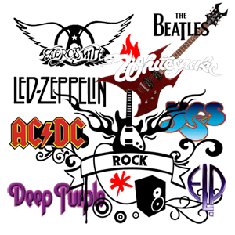
History of Pop Rock Music
“Rock music, sometimes also known as "rock and roll," is a popular style of music that became popular in the 1950s/60s in America and Europe. It evolved from rock and roll and pop music during the 60’s and is primarily based on older musical styles, such as the rhythm and blues music originated by African American performers such as Chuck Berry and Little Richard, with a heavy focus on guitar, drums, and powerful vocals.”
History of Rock- Over the years rock has changed and developed in to a variety of styles such as folk rock which was made popular by artists such as Bob Dylan and often featured acoustic guitars and ‘socially conscious lyrics’. There was also Psychedelic rock made popular by Pink Floyd and often featured dissonant music which was influenced by the use of drugs. Rock is heavily dependent on the use of instruments mainly electric guitars, bass and drums but sometimes uses other instruments to make a fuller sound; rock performances often include long solo performances by those on instruments and can last from 10-20 minutes. Rock has also led to sub-categories and further genres of music such as heavy metal, which features extreme guitar sound and heavy distortion. Examples of heavy metal bands include Led Zeppelin, Black Sabbath and Metallica.
The Main types of Rock include: Hard Rock, Glam Rock, Heavy Metal, Punk, Soft Rock, Trash Metal, Death Metal, Fusion Rock, Black Metal, Power Metal, Gothic Metal/Rock, Industrial Rock, Grunge, Pop Punk, Alternative Rock.

Slide 5
History of Pop Rock Music
Top 25 Rock Songs of all time voted by listeners of Planet Rock:
Led Zeppelin- Stairway to Heaven
Queen- Bohemian Rhapsody
Lynyrd Skynyrd- Free Bird
Deep Purple- Smoke on the Water
Pink Floyd- Comfortably Numb
Led Zeppelin- Kashmir
Rainbow- Stargazer
Free- All Right Now
Led Zeppelin- Whole Lotta Love
The Who- Won’t Get Fooled Again
Guns N’ Roses- Sweet Child O’ Mine
AC/DC- Back in Black
Led Zeppelin- Rock and Roll
14. AC/DC- Whole Lotta Rosie
15. Black Sabbath- Paranoid
16. Motorhead- Ace of Spades
17. Deep Purple- Highway Star
18. Rush- The Spirit of Radio
19. AC/DC- Highway to Hell
20. Jimi Hendrix Experience- All Along the Watchtower
21. Bruce Springsteen- Born to Run
22. Queen- We Will Rock You
23. AC/DC- Let There be Rock
24. Jimi Hendrix Experience- Voodoo Child
25. Boston- More Than a Feeling

Slide 6
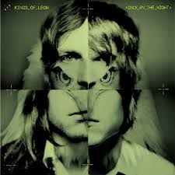
My Favourite Artists within the Pop/Rock Genre Kings of Leon
Kings of Leon is an American band that formed in Nashville, Tennessee, in 1999. The band is composed of brothers Anthony Caleb Followill (January 14, 1982, lead vocals, rhythm guitar), Ivan Nathan Followill (June 26, 1979, drums, percussion, backing vocals) and Michael Jared Followill (November 20, 1986, bass guitar, backing vocals), with their cousin Cameron Matthew Followill (b. September 10, 1984, lead guitar, backing vocals).
Labels- Sony Music, RCA, Columbia, Island
Debut EP, Holy Roller Novocaine, and LP, Youth and Young Manhood in 2003
Manager- Andy Mendelsohn
Top Famous Tracks:
Use Somebody
Sex On Fire
Closer
Pyro
Radioactive
Red Morning Light
Beautiful War
Wait for Me
Cold Desert

Slide 7
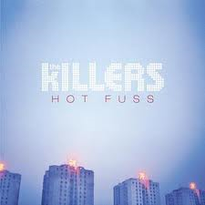
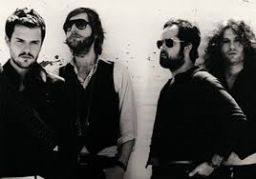
My Favourite Artists within the Pop/Rock Genre The Killers
The Killers are an American band formed in Las Vegas, Nevada in 2001, by Brandon Flowers (lead vocals, keyboards) and Dave Keuning (guitar, backing vocals). Mark Stoermer (bass, backing vocals) and Ronnie Vannucci Jr. (drums, percussion, backing vocals) would complete the current line-up of the band in late 2002. The name The Killers is derived from a logo on the bass drum of a fictitious band, portrayed in the music video for the New Order song "Crystal".
Labels- Island, Vertigo, Marrakesh
Debut album Hot Fuss- Released in 2004 and included some of their top hits with songs such as Mr Brightside, Somebody Told Me, Smile like you Mean It and Jenny was a Friend of Mine.
Manager- Robert Reynolds
Top Famous Tracks from The Killers:
Mr Brightside
Somebody Told Me
Smile Like You Mean It
When You Were Young
Spaceman
Read My Mind
Bones
Human

Slide 8
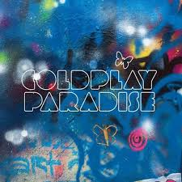
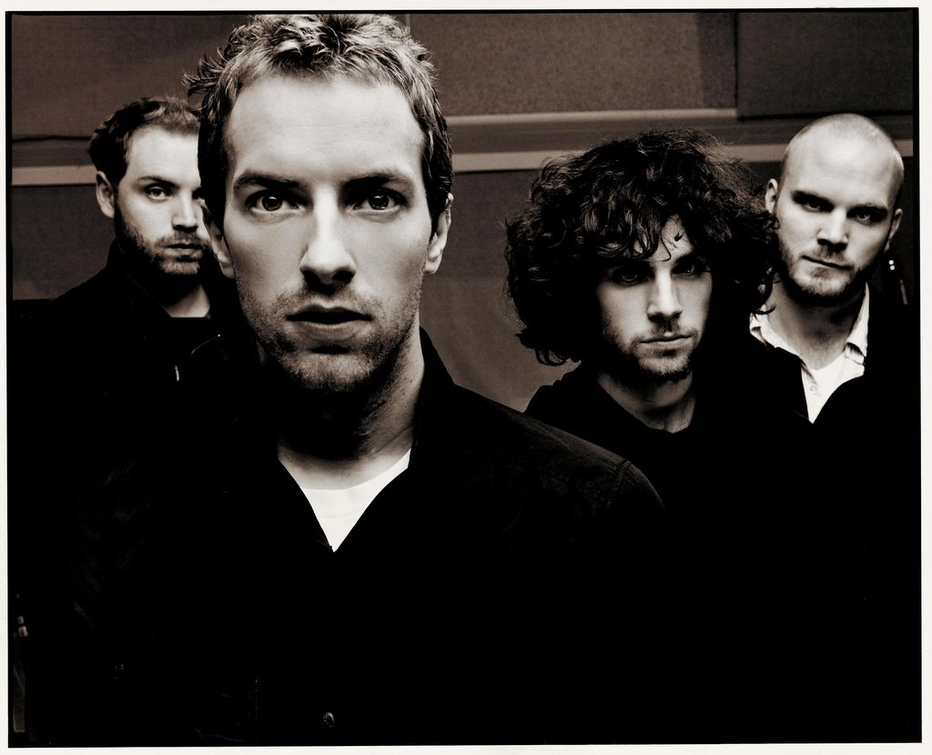
My Favourite Artists within the Pop/Rock Genre Coldplay
Coldplay are a British band formed in 1996 by lead vocalist Chris Martin and lead guitarist Jonny Buckland at University College London. They were primarily called Pectoralz but when Guy Berryman joined the group as a bassist they changed their name to Starfish. Will Champion then joined as a drummer, backing vocalist, and multi-instrumentalist, completing the line-up. The band renamed themselves "Coldplay" in 1998.
Manager- Phil Harvey
Debut- released three EPs: Safety in 1998, Brothers & Sisters as a single in 1999 and The Blue Room in the same year.
They became more popular in 2000 with their release of their single ‘Yellow’ and later within the year their debut album called Parachutes.
Labels- EMI, Parlophone, Capitol, Atlantic
Top Famous Tracks From Coldplay:
Paradise
Fix You
Viva la Viva
Princess of China
Yellow
The Scientist
Clocks
Talk
Lost
In My Place

Slide 9
My Favourite Artists within the Pop/Rock Genre Against The Current
Against The Current is a small up and coming pop/rock-based band from Poughkeepsie, NY. The Band members consist of Chrissy Costanza (Lead vocals), Dan Gow (Vocals/Guitar), Jeremy Rompala (Guitar), Joe Simmons (Bass), and Will Ferri (Drums). The band officially joined Youtube on August 6, 2011 and became pop sensations through their original singles ‘Thinking of You’, ‘Closer, Faster’ and their new single ‘Infinity’. They have also collaborated with other artists on various covers with other well known Youtube artists such as Kurt Schneider and Alex Goot.
Manager- Michael Ferri
Most popular Cover Tracks from ATC:
5 Seconds of Summer- ‘She looks so perfect’
The 1975- ‘Chocolate’
Taylor Swift- ‘All too Well’
Taylor Swift- ‘Red’
Mariah Carey- ‘All I want for Christmas is You’
Original Popular Tracks:
Closer, Faster
Infinity
Thinking of You
Another You
Guessing
Popular Covers with Friends include: Justin Bieber- ‘Beauty and a Beat’, Owl City & Carly Rae Jepson- ‘Good Time’, Demi Lovato- ‘Heart Attack, Kelly Clarkson- ‘Catch my Breath’, Gavin DeGraw- ‘Not Over You’,

Slide 10
My Favourite Artists within the Pop/Rock Genre Fall Out Boy
Fall Out Boy is an American band formed in Wilmette, Illinois in 2001. The band consists of vocalist/guitarist Patrick Stump, bassist Pete Wentz, guitarist Joe Trohman, and drummer Andy Hurley. The band originated from Chicago's hardcore punk scene in which Pete Wentz was heavily involved in; the band was formed by Pete and Joe as a pop punk side project of their respective ‘hardcore’ bands.The group went through a succession of drummers before landing Hurley and recording their debut album, Take This to Your Grave (2003), which became a huge success and helped the band gain a dedicated fan base which was emphasised through heavy touring, as well as some moderate commercial success. This led to further success for their other singles and albums.
Labels- Island, Fueled by Ramen (past), Uprising Records (past)
Manager- Bob McLynn
Top Famous Tracks from Fall Out Boy:
Alone Together
Dance, Dance
I don’t Care
Thnks Fr Th Mmrs
Sugar, We’re going down
The Phoenix

Slide 11
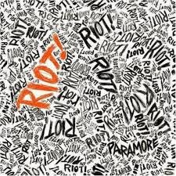
My Favourite Artists within the Pop/Rock Genre Paramore
Top Famous Tracks for Paramore:
Still Into You
Ain’t it Fun
Decode
The Only Exception
Ignorance
Now
That’s What You Get
Monster
Misery Business
All I Wanted
Careful
Daydreaming
When it Rains
Decoy
We are Broken
Proof
Let the Flames Begin
Paramore is an American band from Franklin, Tennessee, formed in 2004. The band consists of lead vocalist Hayley Williams, bassist Jeremy Davis, and guitarist Taylor York. The group released its debut album All We Know Is Falling in 2005.
2nd Album released in 2007- Riot
3rd Album released in 2009- Brand New Eyes
4th Album- Paramore
Labels- Ramen, Atlantic
Manager- Andrew Weiss, Mark Mercado

Slide 12
My Favourite Artists within the Pop/Rock Genre The Vamps
The Vamps are a British pop rock band consisting of members Brad Simpson (lead vocals and guitar), James McVey (lead guitar and vocals), Connor Ball (bass guitar and vocals) and Tristan Evans (drums and vocals).
Formed in 2012 with Mercury Records- First Debut Single: ‘Can We Dance’ and Second Debut Single: ‘Wild Heart’.
Labels- Mercury, Virgin EMI
Manager- Joe O’Neill
Top Famous Tracks By The Vamps:
Can We Dance
Wild Heart
Somebody To You
Somebody To You ft.Demi Lovato
Last Night
Girls on TV
Why Do You Only Call Me When You’re High
Lovestruck
Dangerous
High Hopes

Slide 13
My Favourite Artists within the Pop/Rock Genre Demi Lovato
Demetria Devonne "Demi" Lovato us an American singer and actress that started her career at a young age through acting but developed in to a hugely successful music artist which is her prime career. Demi released her first debut album in 2008 at the age of 16 called Don’t Forget and further released her second album in 2009 called Here We Go Again. Her third album- Unbroken was released in 2011 and included her platinum and top selling single Skyscraper and her fourth self titled album- Demi was released in 2013 and became Demi’s best selling album debut of her career. She has further released top selling songs in addition to Skyscraper and carries out various tours and shows around the world.
Label- Hollywood
Manager- Phillip McIntyre
Top Famous Tracks from Demi Lovato:
Skyscraper
Give Your Heart a Break
Really Don’t Care
Heart Attack
Warrior
Neon Lights
Shouldn’t Come Back
Don’t Forget
For The Love Of A Daughter
My Love’s Like a Star
Unbroken
Hold Up
Let It Go from the top grossing film ‘Frozen’
Made in the USA
This is Me
Lala Land
In Case
Catch Me
Never Been Hurt
Nightingale
Lightweight
Who’s That Boy
Fix a Heart
Believe in Me

Slide 14
My Favourite Artists within the Pop/Rock Genre 5 Seconds of Summer
5 Seconds of Summer (5SOS) are an Australian band formed in Sydney in 2011; the band consists of Luke Hemmings (lead vocals, guitar), Michael Clifford (guitar, vocals), Calum Hood (bass guitar, vocals) and Ashton Irwin (drums, vocals).
They became popular after covering various covers on Youtube before rising to fame through going on tour with One Direction on their Take Me Home Tour.
Exclusive Debut in Australia and New Zealand-’Out of my Limit’ in 2012
In February 2014 they released their debut worldwide single ‘She looks so perfect’.
Album released in June 2014- 5 Seconds of Summer (self-titled)
Labels- Capitol
Managers- Adam Wilkinson
Top Famous Tracks by 5 Seconds of Summer (5SOS)
She Looks so Perfect
Don’t Stop
Good Girls
Gotta Get Out
Out of My Limit
The Only Reason
What I Like About You
Too Late
Unpredictable
Beside You

Slide 15
My Favourite Artists within the Pop/Rock Genre All Time Low
All Time Low is an American band from Towson, Maryland and was formed in 2003. The band consists of vocalist and rhythm guitarist Alex Gaskarth, lead guitarist and backing vocalist Jack Barakat, bassist and backing vocalist Zack Merrick and drummer Rian Dawson.
The band's name is devised from lyrics in the song "Head on Collision" by New Found Glory.
Debut EP was released in 2004- ‘The Three Words to Remember in Dealing with the End’
First Album released in 2005 called ‘The Party Scene’
Labels- Hopeless (Current), Interscope (Past) and Emerald Moon (Past)
Manager- Matt Flyzik
Top Famous Tracks:
Dear Maria, Count me In
Weightless
Time Bomb
Therapy
A Love Like War
Sick Little Games
Umbrella
Break Your Little Heart
The Reckless and The Brave
I Feel Like Dancin’
Walls
Painting Flowers

Slide 16
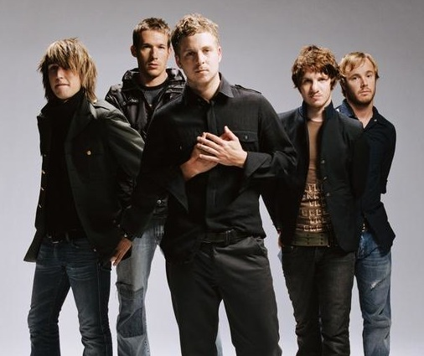
My Favourite Artists within the Pop/Rock Genre One Republic
One Republic’s Top Famous Tracks:
Counting Stars
Love Runs Out
Secrets
If I Lose Myself
Good Life
I Lived
Say
Everybody Loves Me
Good Life
Something I Need
Feel Again
Burning Bridges
Say
Preacher
Tyrant
All Fall Down
All This Time
Can’t Stop
Mercy
Life In Colour
Passenger
One Republic is an American band from Colorado Springs, Colorado. They were Formed in 2003 by Ryan Tedder and Zach Filkins and originated from being an unsigned act on MySpace before being discovered by a Hollywood actress who had contacts with those in charge of Sony at the time; they stayed at Sony for 3 years before changing their record label.
In 2007 One Republic released their debut album- ‘ Dreaming Out Loud’ which included their lead single ‘Apologise’.
2nd Single- Stop and Stare
One Republic released their second album in 2009 called ‘Waking Up’ which included further highly successful singles such as: ‘All the Right Moves’, ‘Secrets’, ‘Marchin’ On’ and ‘Good Life’.
Third album released in 2013 called ‘Native’ and ended up being One Republic’s highest charting album to date along with their top singles ‘Counting Stars’ and ‘If I lose Myself’.
Labels- Sony (Past), Columbia, Mosley and Interscope
Manager- Ron Laffitte

